Slide 1
Computational Thinking
Core Concepts | Lessons 1 and 2 | Transition Year

Slide 2
Warm up: instruct a robot
A robot has never seen a kitchen.
Write the instructions it needs to make a slice of toast.
Write your steps. Aim for eight or fewer.
1
Swap with a partner. Follow their steps exactly, like a robot. Where does it go wrong?
2
What did you have to break down? What did you assume the robot already knew?
3
Notes:
Starter, about 5 minutes. Give students 3 minutes to write instructions for making toast, then swap with a partner who follows them exactly, like a robot. Typical failures: the packet is never opened, the bread is never put in the toaster, nobody says to plug it in. Collect two or three examples. Do not name the techniques yet. Come back to this at the end of the abstraction section: what did you assume the robot already knew, and what did you have to spell out?

Slide 3
Two lessons, four big ideas
Lesson 1 Breaking problems down
Lesson 2 Patterns and instructions
Decomposition
Abstraction
Pattern recognition
Algorithmic thinking
Worksheet activities
Worksheet activities
Delivery robot
Make a snowman
London Underground map
Gathering important facts
Finding order: tomato soup
Spot the correct pattern
Create a pattern
Complete the worksheets online. Use My answers to copy your work into Classroom.
Notes:
Overview for the class. Lesson 1 is about taking a problem apart and deciding what matters. Lesson 2 is about spotting repeats and writing instructions. Each lesson is about an hour. The worksheets are online: students complete them on the page and use the My answers tab to copy their work into Google Classroom.

Slide 4
What is Computational Thinking?
Computational thinking is a way of understanding complex problems in order to form a solution that can be implemented by either a computer, a human or a combination of both.
There are four key elements to computational thinking:
Decomposition
Lesson 1
Abstraction
Lesson 1
1
Breaking a problem down into smaller pieces.
2
Removing details that are not relevant to solving a problem.
Pattern recognition
Lesson 2
Algorithmic thinking
Lesson 2
3
Finding patterns or similarities.
4
Identifying the logical steps, a set of instructions, that solve a problem.

Slide 5
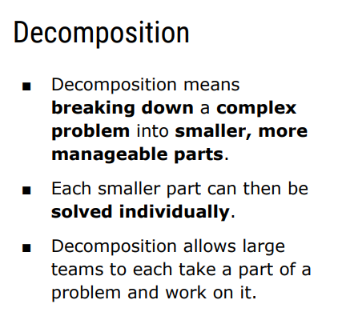

Slide 6
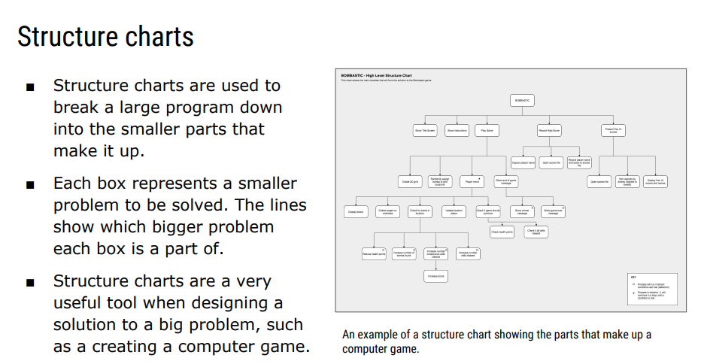

Slide 7
Decomposition in action
Organise a school trip
Book transport
Get permission
Plan the day
Choose a date
Get a quote
Write the letter
Collect forms
Plan the route
Pack lunches
Keep splitting until each box is small enough to just do. Different people can take different boxes and work at the same time.
Notes:
A quick worked example before the Delivery Robot worksheet. Point out that every box is a smaller problem than the one above it, and that each bottom box is small enough to just do. Ask: which of these could be done by different people at the same time? Link back to the Bombastic structure chart on the previous slide.

Slide 8
Your turn: decomposition
Delivery robot
15 min
Make a snowman
10 min
Read the structure chart.
Name the five sub-tasks of the main task.
Pick one sub-task and break it down further.
Put the eight steps in an order that works.
Pick one step and break it into smaller tasks.
Which steps could be done in any order?
Success check: every box in your answer is a smaller problem than the box above it.
Notes:
Hand over to the online worksheets. Delivery Robot is the main task, about 15 minutes. Make a snowman is about 10 minutes. Circulate and check that students are writing sub-tasks as full sentences, and that each new box is smaller than the one above it. Fast finishers can try breaking down a second sub-task.

Slide 9
Abstraction
A Technique that is used to simplify a problem by removing unnecessary parts.
Allows you to focus on what is important and relevant
Where is abstraction useful.
Give an example of how abstraction might be used in
  Maths
  English
  Geography

Slide 10
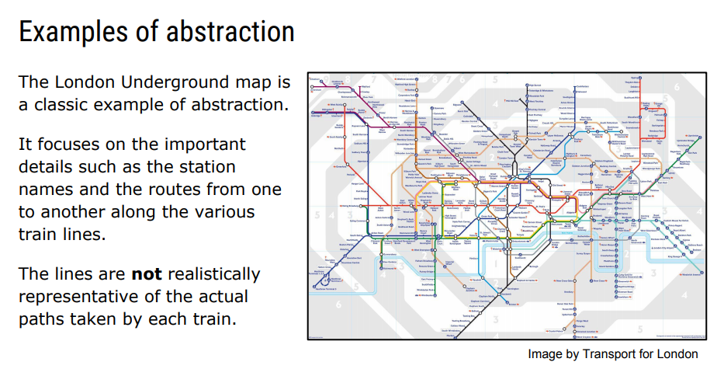

Slide 11
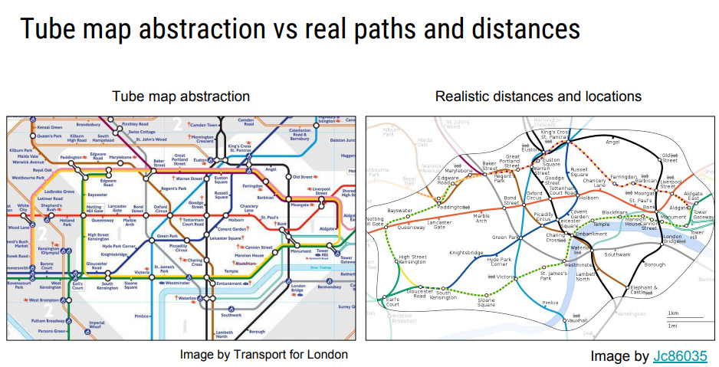

Slide 12
Your turn: abstraction
The Underground map
15 min
Gathering facts
10 min
Slide between the simplified and realistic map.
Sort the details: keep or remove?
Explain why the real map was simplified.
Highlight only the sentences that help answer the question.
Work out what was found and how you know.
Write three questions about the important facts.
Ask yourself: does this detail help me answer the question?
Notes:
Underground map is about 15 minutes: students slide between the simplified and realistic map, sort details into keep or remove, then answer three written questions. Gathering important facts is about 10 minutes. Come back to the warm-up: what did the robot need to be told, and what could you leave out?

Slide 13
Lesson 1 recap
Decomposition
Abstraction
The question it asks
How can I split this into smaller parts?
The question it asks
Which details matter for this problem?
What you do
Break it into sub-tasks, then break those down again.
What you do
Keep the important details and leave out the rest.
Example
A structure chart for a game
Example
The London Underground map
Notes:
Plenary for Lesson 1. Ask students to say which technique they used for each worksheet. Decomposition: delivery robot, snowman. Abstraction: Underground map, gathering facts. Then: which of the two is about what to include, and which is about how to split? Exit ticket: write one example of each from outside school.

Slide 14
Starter: what comes next?
2, 4, 6, 8, ?
1, 4, 9, 16, ?
100, 90, 80, ?
Work out the next number in each pattern.
Then describe the rule in one sentence. Could someone else follow your rule?
Notes:
Starter, about 5 minutes. Answers: 10, 25, 70. Ask students to explain the rule in one sentence. The second is square numbers, so the gap grows by 2 each time. Point out that the rule they described is the start of an algorithm, and that spotting the rule is pattern recognition.

Slide 15
Pattern recognition
Finding things that repeat or are similar.
Numbers
Shapes
Instructions
5, 10, 15, 20
Forward 50
Turn 90° clockwise
Forward 50
Turn 90° clockwise
Add 5 each time.
Red and blue take turns.
The same two lines repeat.
Why it matters: if you spot a pattern, you can write it once and repeat it.
Notes:
Pattern recognition is spotting things that repeat or are similar. The reason it matters for programming: once you see a repeat, you can write it once and tell the computer to do it again. That idea is the Repeat instruction we use in the next few slides.

Slide 16
Algorithmic thinking
An algorithm is a set of step-by-step instructions, in the right order, that solves a problem.
Wet the brush
Add the toothpaste
Brush for two minutes
Rinse
Brushing your teeth is an algorithm.
Order matters
Rinse before you brush and it does not work.
Detail matters
A computer does exactly what the steps say, and nothing more.
Notes:
An algorithm is step-by-step instructions in the right order. Use the tooth-brushing chevrons to show that order matters: ask what happens if rinse comes before brush. Stress that algorithms are not only for computers. Recipes, directions and board game rules are algorithms. The tomato soup worksheet is an order task of exactly this kind.

Slide 17
Repeat instead of rewriting
Without a loop
With Repeat
What it draws
Pen down
Forward 50
Turn 90° clockwise
Forward 50
Turn 90° clockwise
Forward 50
Turn 90° clockwise
Forward 50
Turn 90° clockwise
Pen down
Repeat 4
Forward 50
Turn 90° clockwise
The arrow shows the start.
Forward moves the pen. Turn rotates it. Pen up stops drawing. Repeat runs the lines inside it again.
Notes:
This sets up Spot the Correct Pattern. Both programs draw the same square: the left one writes the pattern out four times, the right one uses Repeat. Ask students to trace the right-hand program with a finger on the diagram. Clockwise is the direction a clock hand moves. Start by facing right, which is the way the red arrow points.

Slide 18
Writing a number pattern
Instructions
Number = 1
Output Number
Repeat until Number >= 32
Number = Number * 2
Output Number
Variable
Number is a named box that stores a value.
Repeat
The indented lines run again until the condition is true.
Output
More than one way
Different instructions can make the same pattern.
1, 2, 4, 8, 16, 32
Your task: write instructions for three patterns.
Notes:
Bridge into Create a Pattern. Walk through the example line by line: Number starts at 1, we output it, then keep doubling and outputting until Number reaches 32. A variable is a named box that stores a value. Indent the lines that sit inside the Repeat. Remind students that there can be more than one correct algorithm. Note: the printed worksheet's example (Repeat until Number > 35) would also output 64, so the online version stops at >= 32.

Slide 19
Your turn: patterns and algorithms
Finding order
Spot the pattern
Create a pattern
Tomato soup | 10 min
Six shapes | 20 min
Number patterns | 20 min
Read every step first.
Drag the steps into an order that works.
Which two steps could swap?
Look at each shape.
Pick the instructions that draw it.
Use Draw it to check.
Write instructions for each pattern.
Run them to check the output.
Invent your own for a partner.
Notes:
Three online activities. Finding order is about 10 minutes, Spot the Correct Pattern about 20, Create a Pattern about 20. In Spot the Correct Pattern students pick first, then use Draw it to see what each set of instructions makes. In Create a Pattern the page runs their instructions and checks the output. Fast finishers invent their own pattern and challenge a partner.

Slide 20
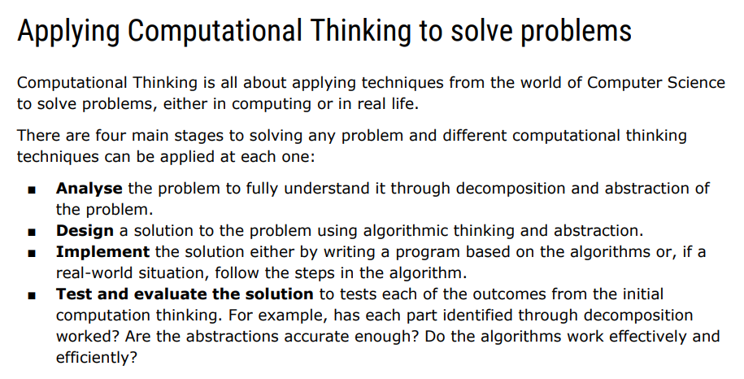

Slide 21
Exit questions
Which two elements did we use in Lesson 1?
1
How does spotting a pattern help you write shorter instructions?
2
Name the four stages of solving a problem. Match one technique to each.
3
Notes:
Plenary for the topic. After the four-stages slide, ask three questions. Suggested answers: 1) Decomposition and abstraction. 2) A pattern can be written once and repeated, so the instructions are shorter and easier to check. 3) Analyse (decomposition, abstraction), Design (algorithmic thinking, abstraction), Implement, Test and evaluate.

